Slide 1
C programming
TEAM MEMBERS:
Ahamed absar S A
Pravinth C

Slide 2
Definition of C
C is a general-purpose high level language that was originally developed by Dennis Ritchie for the Unix operating system.
It was mainly developed as a system programming language to write an operating system

Slide 3
TOPICS
Operators.
Control statements.
Arrays.
String.
Storage class.
Structure.
Union.

Slide 4
Operators in C
An operator specifies an operation on operands.
Operators are used to connect operands,
i. e., constants and variables, to form expressions.

Slide 5
TYPES OF OPERATORS
1) Assignment operator (=)
2) Arithmetic operator (+,-,*,/,%)
3) Relational operator (<,>,<=,>=,==,!=)
4) Logical operator (&&,,||, !)
5) Bitwise operator (&,|, ^,~,<<,>>)

Slide 6
6) Conditional operator (?:)
7) Sizeof operator
8) Comma operator
9) increment/decrement operators (++/--)
10) other operatos ( . -> [] & * ....).

Slide 7
Assignment Operator
Assignment operator ‘=’ is used within any valid
expression. It is used to assign values to variable.
Syntax:
variable = expression;
Ex: int a=10;

Slide 8
Arithmetic operators
Arithmetic operators are categorised as:
Unary operator: unary arithmetic operators require
operand.
- : negative sign (unary minus)
+ : positive sign (unary plus)
++ : increment
-- : decrement

Slide 9
Binary operator : binary operators require 2 operands.
+ : addition
- : subtraction
* : multiplication
/ : division

Slide 10
Increment and decrement (++/--)
Increment operators are used to increase the value of the
variable by one and decrement operators are used to
Decrease the value of the variable by one in C programs.
Eg:
increment:x++(x+1).
Decrement :x–(x-1).

Slide 11
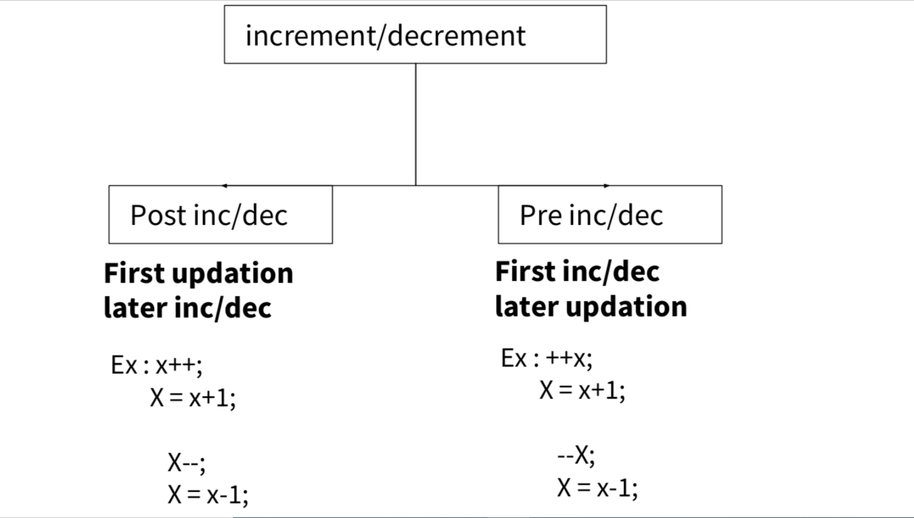

Slide 12
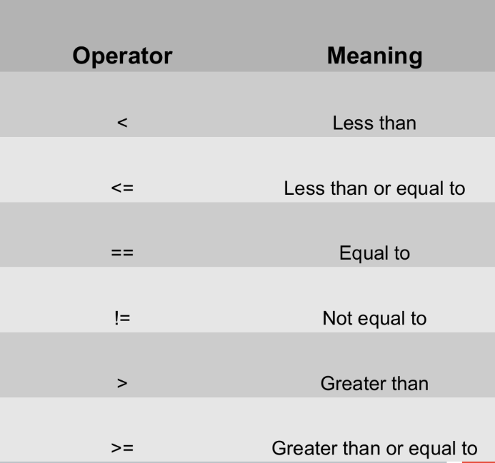
Relational Operators
Relational operators in C are commonly used to check the relationship between the two variables. If the relation is true, then it will return value 1. Otherwise, it returns a value 0.

Slide 13
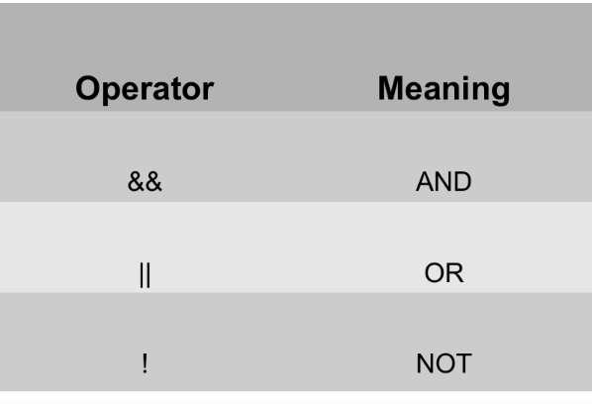
Logical Operator
Logical operators are part of binary operators. These operators are specifically used when we are going to
combine two or more operands together.

Slide 14
Conditional Operator
Conditional operator (?:) takes three operands,
thus a ternary operator.
Expression1 ? Expression2 : Expression 3;
If expression 1 is true they, print expression 2 and
expression1 is false then print expression 3.

Slide 15
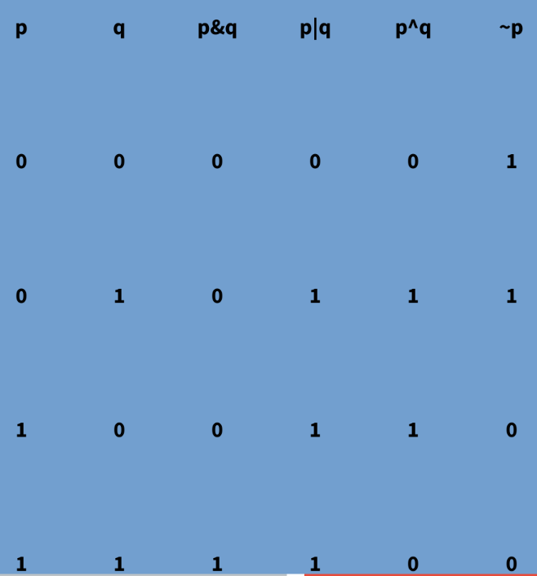
Bitwise operator
Bitwise Operators are used for operations on Individual bits (Note that it is bits not Bytes. One Byte contains 8 bits).
& : bitwise AND
| : bitwise OR
^ : bitwise XOR
~ : bitwise NOT
>> : shift right
<< : shift left

Slide 16
Comma(,) operator
The Comma operator Separates the Expressions.
it, evaluates the operands present after this, and then returns the result/value accordingly.
Eg:
int x,y,z;

Slide 17
Sizeof operator
The sizeof operator returns the size of the operand. That means, from the return value of Sizeof operator, we can clearly say how many bytes allocated to hold the particular operand in the computer memory.
syntax:
Sizeof (data_type);

Slide 18
Reference (&) and Dereference (*) Operators
C has pointer concept, where we can deal with memory addresses. & operator references address of a variable, as seen in scanf().
Dot (.) and Arrow (–>) Operators
In C, the . (dot) and the –> (arrow) operators access individual
elements of structures and unions.

Slide 19
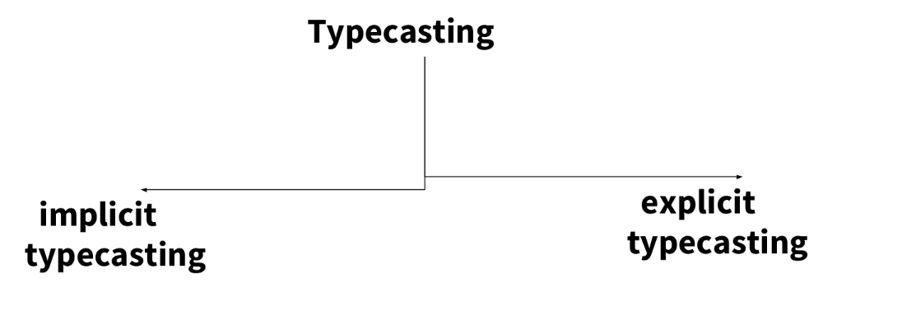
Typecasting
It's a temporary conversion of one form of datatype into another form of datatype is called as Typecasting.

Slide 20
explicit typecasting : explicitly user has to typecast the
datatype.
implicit typecasting : the typecasting is automatically done by compiler. Where the lower datatype is converted into higher
data-type.

Slide 21
Control statements
Control statements enable us to specify
the order in which the various instructions
in the program are to be executed.
In C programs, statements are executed sequentially in the order in which they appear in the program.
But sometimes we may want to use a condition for executing only a part of program.

Slide 22
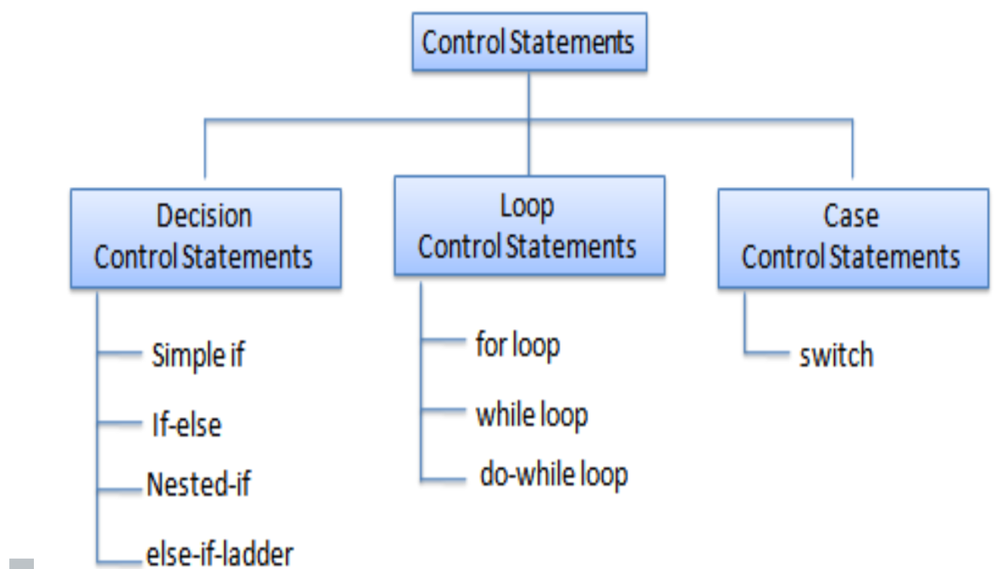
Types
This determines the flow of control. Control statements defines how to control is transferred to other parts of the program.

Slide 23
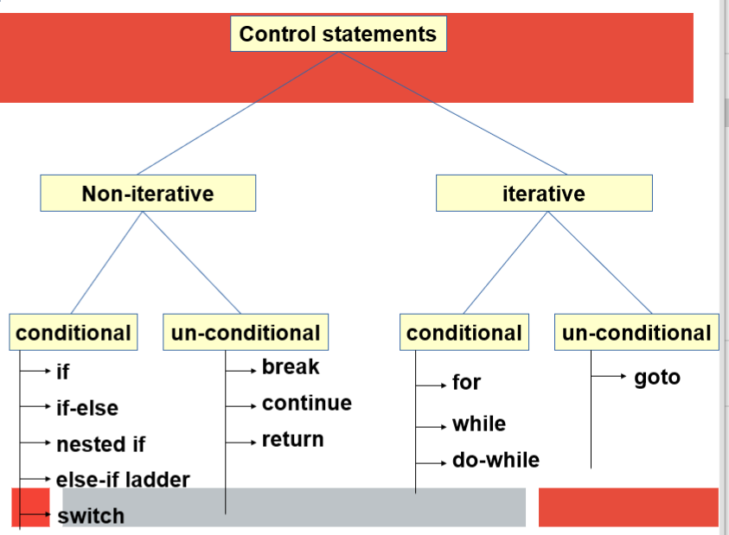

Slide 24
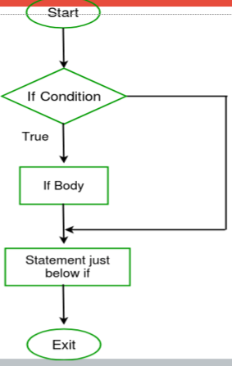
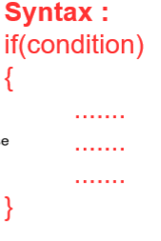
IF CONDITION:
Note : if condition is true, then it will treat that
condition valueas 1 and execute the statement.
But if condition is false,then it will treat that value
as 0 and will not execute the statements.
SYNTAX:

Slide 25
Example:
int main() {
int i = 10;
if (i > 15)
{
printf("i is greater than 15");
} o/p:
printf("I am Not in if"); I am not in if
}

Slide 26
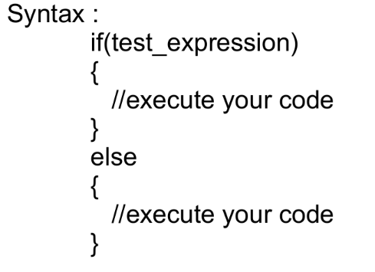
If-else condition
Description :
If else statements in C is also used to control the program flow based on some condition, only the difference is, it's used to execute some statement code block if the expression s evaluated to true,otherwise executes else statement code block.

Slide 27
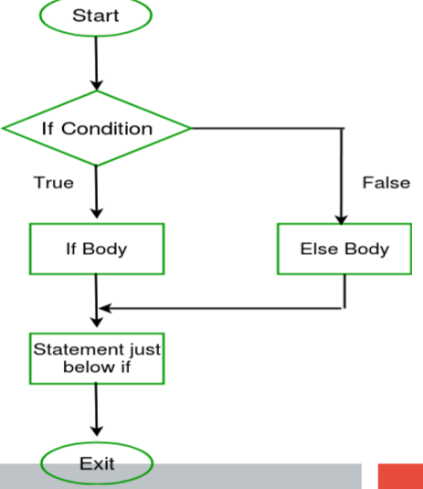
Flow chart

Slide 28
example:
int main() {
int i = 20;
if (i < 15)
printf("i is smaller than 15");
else
printf("i is greater than 15");
Output:
i is greater than 15
return 0;
}

Slide 29
Nested-if condition
syntax:
if(test_expression one)
{
if(test_expression two)
{
//Statement block Executes
}
}
else {
//stataments for else
}

Slide 30
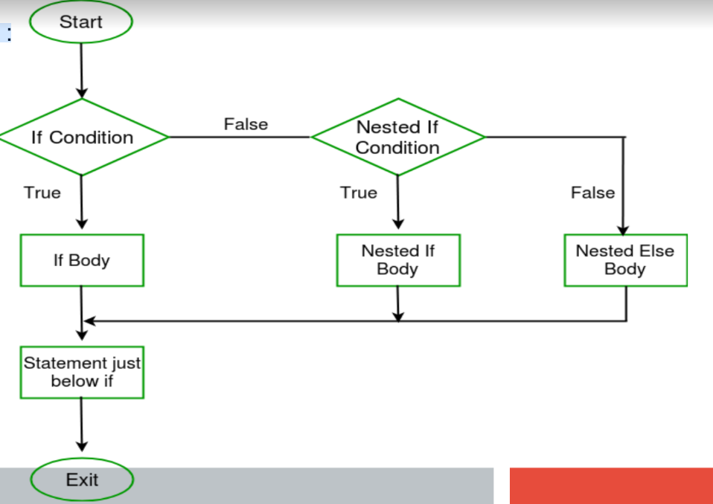
Flow chart

Slide 31
Example
int main(){
int i = 10;
if (i == 10)
{
// First if statement
if (i < 15)
printf("i is smaller than 15\n");
if (i < 12)
printf("i is smaller than 12 too\n");
else
printf("i is greater than 15");
}
}
Output:
i is smaller than 15
i is smaller than 12 too

Slide 32
syntax: if(test_expression)
{
//execute your code
}
else if(test_expression n)
{
//execute your code
}
Else
{
//execute your code
}
else-if ladder condition

Slide 33
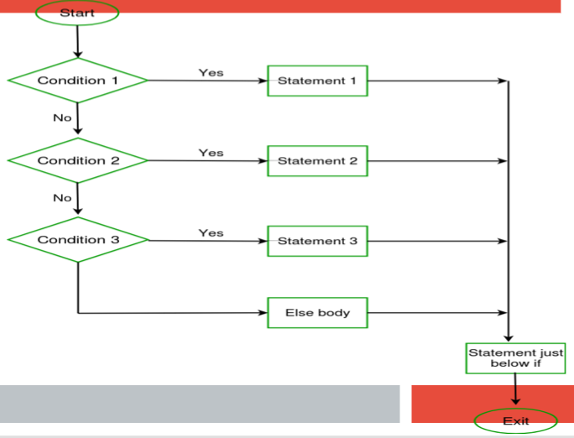
Flow chart

Slide 34
Example:
int main() {
int i = 20;
if (i == 10)
printf("i is 10");
else if (i == 15)
printf("i is 15");
else if (i == 20)
printf("i is 20");
else
printf("i is not present");
}
Output:
i is 20

Slide 35
Syntax:
switch (n)
{
case 1: // code to be executed if n = 1;
break;
case 2: // code to be executed if n = 2;
break;
default: // code to be executed if n doesn't match any cases
}
Switch Statement in C

Slide 36
Restrictions of switch
cases
1. The switch case statements must be either integer constant or char constant only.
2. switch case labels should not be Variables,Floating point numbers,Strings,Duplicate cases and etc.
3. break is keyword should be used for switch cases to execute only the particular cases.
4. if there is no break, then the control is automatically falls to the next cases for
execution until there is break found.

Slide 37
Example :
int main()
{
int x = 2;
switch (x)
{
case 1: printf("Choice is 1");
break;
case 2: printf("Choice is 2");
break;
case 3: printf("Choice is 3");
break;
default: printf("Choice other than 1,2and 3");
Break;
}
}
Output:
Choice is 2.

Slide 38
Jump Statements in C
1) goto
2) break
3)continue
4)Return
C goto :
The goto statement in C also referred to as unconditional jump
statement can be used to jump from one point to another within
a function.

Slide 39
syntax:
Syntax1 | Syntax2
------------------------------
goto label; | label:
. | .
. | .
. | .
label: | goto label
Description :
the first line tells the compiler to go to or jump to the statement marked as a label. Here label is a user-defined
identifier which indicates the target statement.
The statement immediately followed after ‘label:’ is the destination statement.

Slide 40
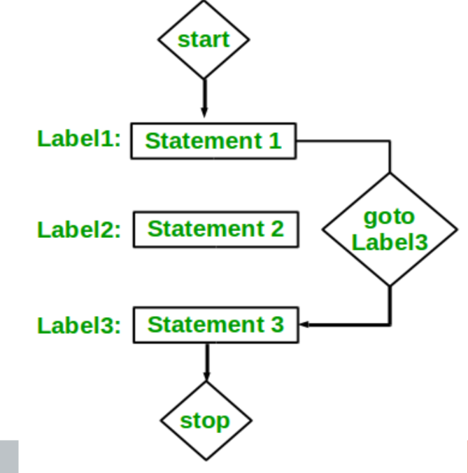
Flow chart

Slide 41
Example:
int main()
{
printf ( “hello\n” ) ;
label: printf ( “hi\n” ) ;
printf ( “goto test\n” ) ;
goto label;
printf (“after goto\n”);
}
Output:
Hello
hi
goto test
Hi
Goto test
.
.
.

Slide 42
Loops in C
Loops in programming come into use when we need to repeatedly
execute a block of statements.
Example:
Suppose we want to print “Hello World” 10 times.This can be done
in two ways as shown below:
Iterative Method:
An iterative method to do this is to write the printf() statement
10 times.

Slide 43
Types of Loops
Entry Controlled loops :
In this type of loops the test condition is tested before entering the loop body. For Loop and While Loop are entry.
Exit Controlled Loops:
In this type of loops the test condition is tested or evaluated at the end of loop body.Therefore,he loop body will execute atleast once,irrespective
of whether the test condition is true or false do – while loop is exit controlled loop.

Slide 44
Iterative loop statements
in C
while
do ... while
for
while:
-> The while loop in C is used in situations where we do not know the
exact number of iterations of loop beforehand.The loop execution
is terminated on the basis of the test condition.
-> Suppose, we want to print "He is the best" 10 times. One way to
get the desired output. We write 10 printf statements, which is
not preferable.

Slide 45
Syntax:
while (test_expression)
{
// statements
update_expression;
}
Example:
i <= 10
Update Expression: After executing the loop body, this increments/decrements the loop variable by some value.

Slide 46
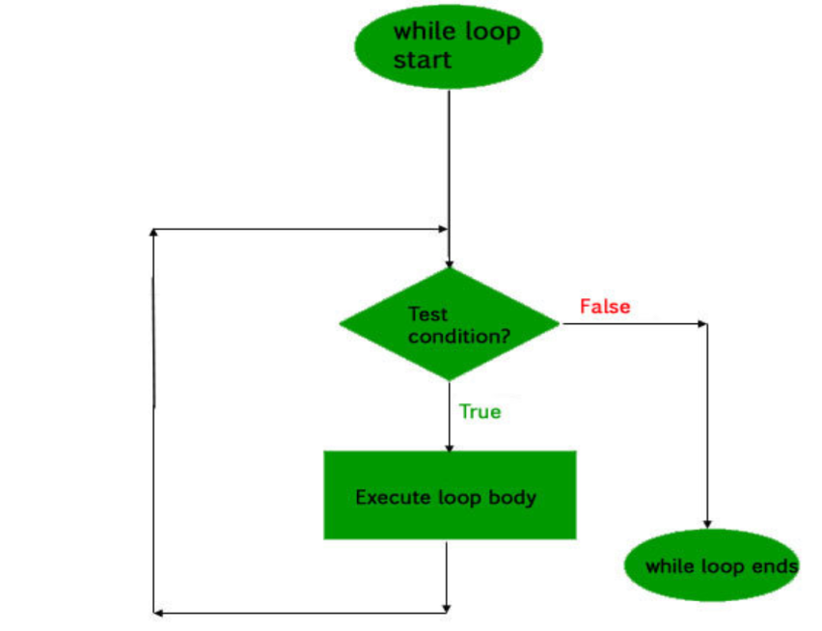
while loop in C

Slide 47
examples:
int main()
{
int i = 1;// Initialization expression
while (i < 6)
{
// loop body
printf("Hello World\n");
// update expression
i++;
}
} output:
Hello World
Hello World
Hello World
Hello World
Hello World

Slide 48
do .. while loop in C
syntax:
initialization expression;
do
{
// statements
update_expression;
} while (test_expression);
Note: Notice the semi – colon(“;”) in the end of loop.

Slide 49
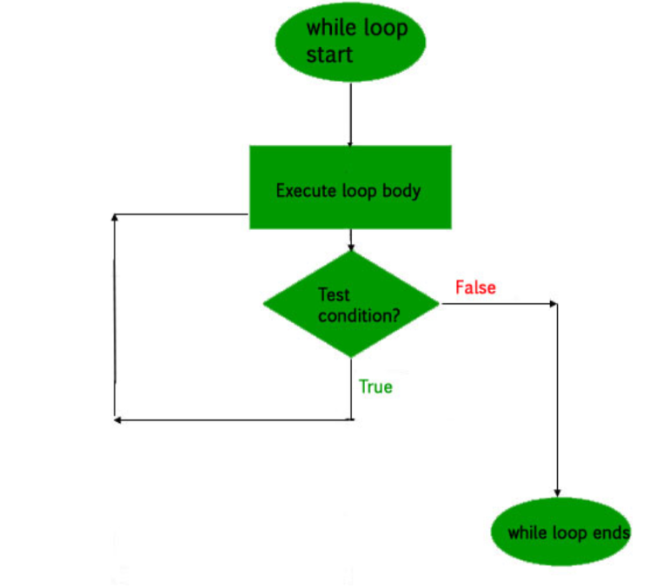
Flow chart

Slide 50
examples:
int main()
{
int i = 2; // Initialization expression
do
{
// loop body
printf( "Hello World\n");
// update expression
i++;
} while (i < 1); // test expression
}
Output:
Hello world

Slide 51
for loop in C
syntax:
for (initialization expr; test expr; update expr)
{
// body of the loop
// statements we want to execute
}
Description:A for loop is a repetition control structure which allows us to write a loop that is executed a specific number of times.The loop enables us to perform n number of steps together in one line.

Slide 52
Example :
i <= 10;
Initialization Expression :
In this expression we have to initialize the loop counter to some
value.
Example :
int i=1;
Test Expression :
In this expression we have to test the condition. If the condition
evaluates to true then we will execute the body of loop and go
to update expression otherwise we will exit from the for loop.

Slide 53
examples:
int main()
{
int i=0;
for (i = 1; i <= 5; i++)
{
printf( "Hello World\n");
}
return 0;
}
Output
Hello World
Hello World
Hello World
Hello World
Hello World

Slide 54
Infinite loop in C
Example :
int main ()
{
int i;
for ( ; ; )
{
printf("This loop will run forever.\n");
}
Output:
This loop will run forever.
This loop will run forever.

Slide 55
Break statement in C
Syntax :
break;
Description :
This loop control statement is used to terminate the loop. As soon as the break statement is encountered from within a loop, the loop iterations stops there and control returns from the loop
immediately to the first statement after the loop.

Slide 56
Return statement in C
The return in C returns the flow of the execution to the function from where it is called.
The return statement may or may not return anything for void function, but for a non-void function, a return value is
must be returned.
Return is used in functions, In a function once return is executed,control is back to whoever called that function.

Slide 57
Continue statement in C
Continue is exclusively used in loops.In a program, If we use continue, the loop is continued till the condition is false.
The continue statement is opposite to that of break statement, instead of terminating the loop, it forces to execute the next iteration of the loop.
When the continue statement is executed in the loop.The code inside the loop following the continue statement will be skipped and next iteration of the loop will begin.

Slide 58
Nested for loop in C
Description :
Nested loop means a loop statement inside another loop statement. That is why nested loops are also called as “loop inside loop“.
Syntax:
for ( initialization; condition; increment )
{
for ( initialization; condition; increment )
{
// statement of inside loop
}
//statement for outerloop
}

Slide 59
examples:
int main()
{
Int I, j ;
for (i = 1; i < 2; i++)
{
printf( “three\n”) ; output:
for (j = 1; j < 2; j++) three
{ one
printf( “one\n”) ; two
printf( “two\n”) ; three
} one
} two
}

Slide 60
Arrays
It is a collection of similar data items which
are Stored in a contiguous memory
locations.

Slide 61
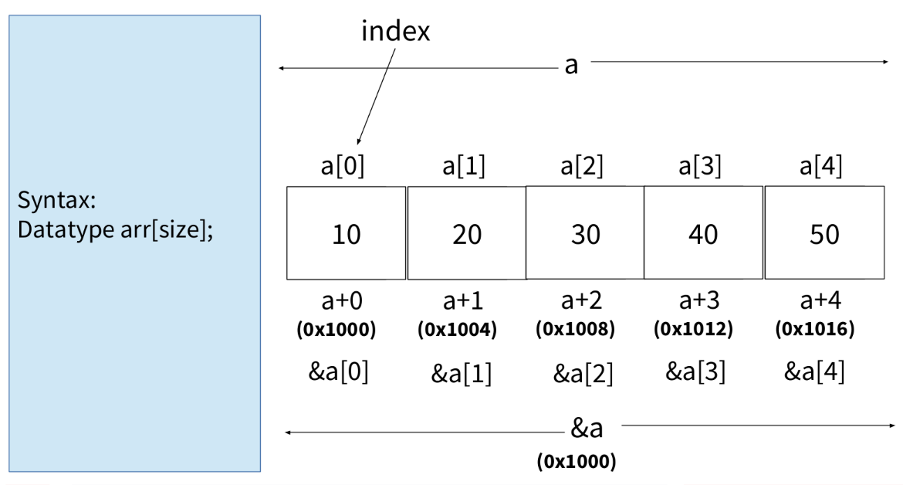
Create an array for 5 integers.

Slide 62
int a[5] = {10,20,30,40,50};
Formulae :
a[i] = *(a+i);
= *(i+a);
= i[a];
So, finally, a[i] = i[a];
&a[i] = &*(a+i);
= a+i;
&a[i] = a+i;
An array name, itself
representing as base address.

Slide 63
#include<stdio.h>
int main()
{
int a[5] = {10,20,30,40,50};
printf("%d %d %d%d%d\n",a[0],a[1],a[2],a[3],a[4]);
printf("%d %d %d %d %d\n",0[a],1[a],2[a],3[a],4[a]);
printf("%p %p %p %p%p\n",&a[0],&a[1],&a[2],&a[3],&a[4]);
printf("%p %p %p %p %p\n",a+0,a+1,a+2,a+3,a+4);
}
Examples 1:

Slide 64
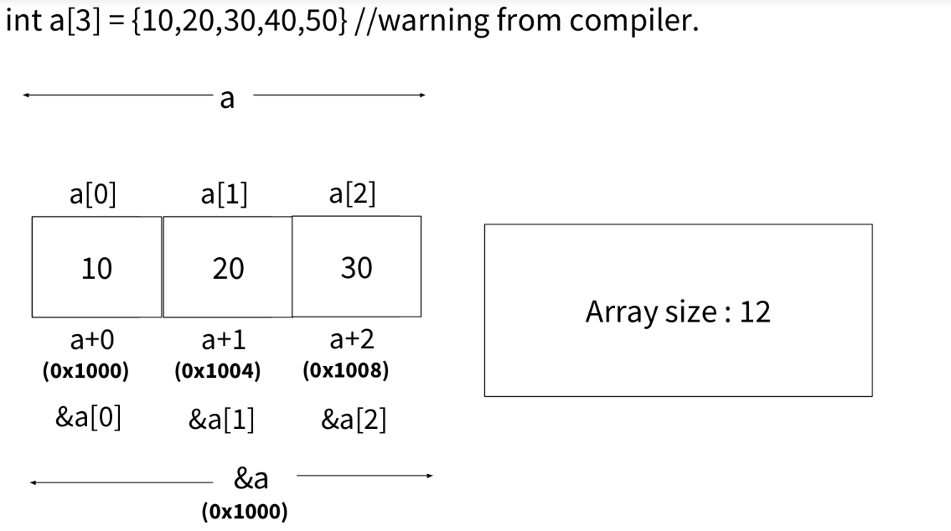
Create an array of 5 integer

Slide 65
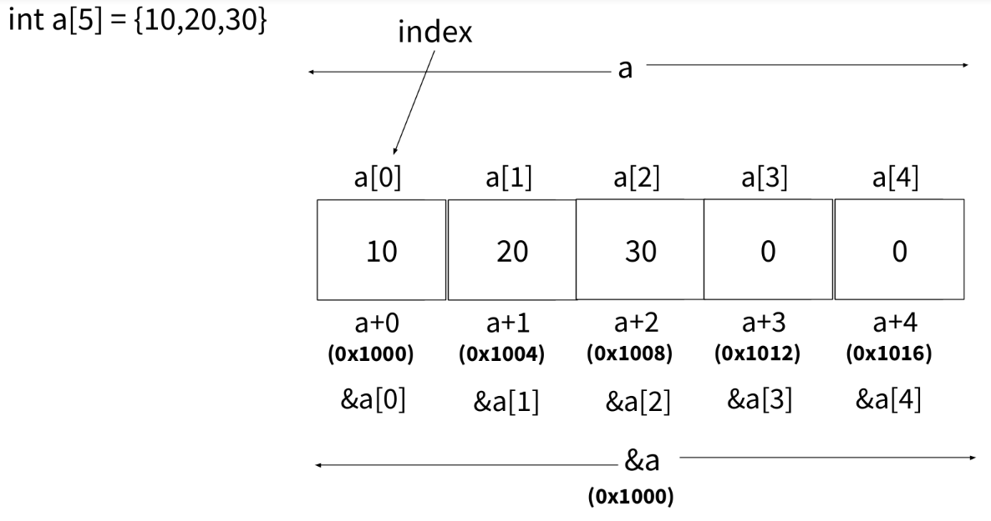
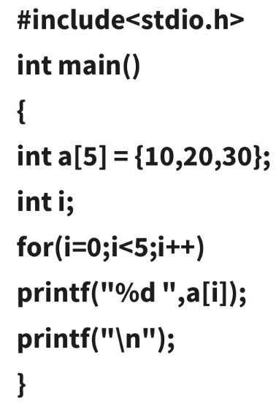
Create an array for 5 integers.

Slide 66
write a program to scan 5 integers into an array and display it.
#include<stdio.h>
int main()
{
int a[5],i;
printf("Enter the array elements\n");
for(i=0;i<5;i++)
scanf("%d",&a[i]); //(or) scanf("%d",a+i);
for(i=0;i<5;i++)
printf("%d ",i[a]);
printf("\n");
}

Slide 67
WAP to check that array elements are palindrome
format or not.
#include<stdio.h>
int main()
{
int a[] = {10,20,30,40,50,55,40,30,20,10};
int i,j,n;
n = sizeof a/sizeof a[0];
for(i=0;i<n;i++)
printf("%d ",a[i]);
printf("\n");

Slide 68
for(i=0,j=n-1;i<j;i++,j--)
{
if(a[i] != a[j])
break;
}
if(i<j)
printf("not palindrome format...\n");
else
printf("palindrome format...\n");

Slide 69
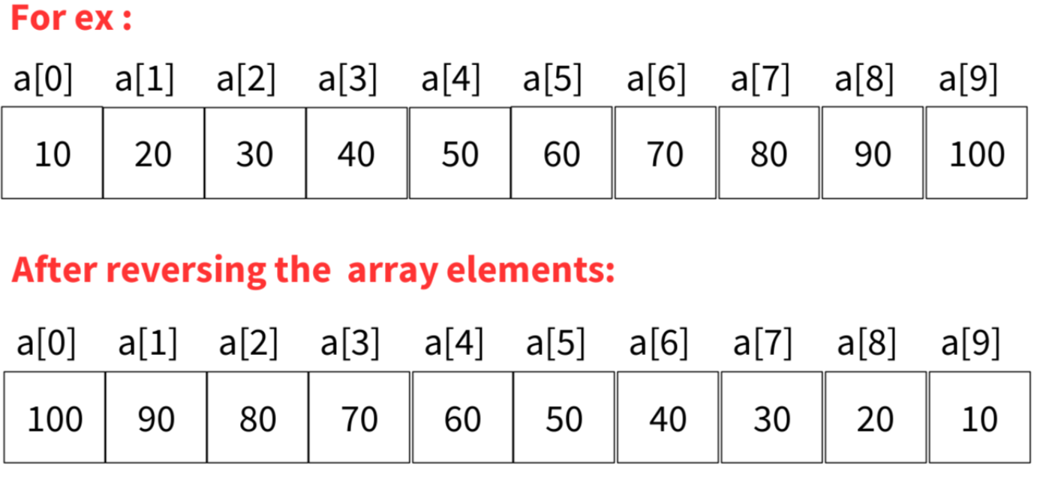
Write a program to reversing the array elements in
a given array.

Slide 70
int main()
{
int a[] = {10,20,30,40,50,60,70,80,90,100};
int i,j,ele,temp;
ele = sizeof a/sizeof a[0];
printf("Before reversing, array elements are...\n");
for(i=0;i<ele;i++)
printf("%d ",a[i]);
printf("\n");
#include<stdio.h>

Slide 71
for(i=0,j=ele-1;i<j;i++,j--)
{
temp = a[i];
a[i] = a[j];
a[j] = temp;
}
printf("After reversing , array elements are...\n");
for(i=0;i<ele;i++)
printf("%d ",a[i]);
printf("\n");

Slide 72
Find 2nd big element in an array
#include<stdio.h>
int main()
{
int a[] = {10,10,10,10,26,1,83,17,26,72,34,34,19,83};
int i,big1,big2, n = sizeof a/sizeof a[0];
for(i=0;i<n;i++)
printf("%d ",a[i]);
printf("\n");
if(a[0]<a[1])
big1 = a[1],big2 = a[0];
else
big1 =a[0],big2=a[1];

Slide 73
for(i=2;i<n;i++)
{
if(a[i] > big1)
{
big2 = big1;
big1 = a[i];
}
else if( (a[i] > big2)&&(a[i]!=big1) )
big2 = a[i];
printf(“%d%d\n”,big1,big2);
}

Slide 74
String
It is a collection of characters, which are stored in
Contiguous memory location and it it enclosed with
double quotes and terminated with null character.

Slide 75
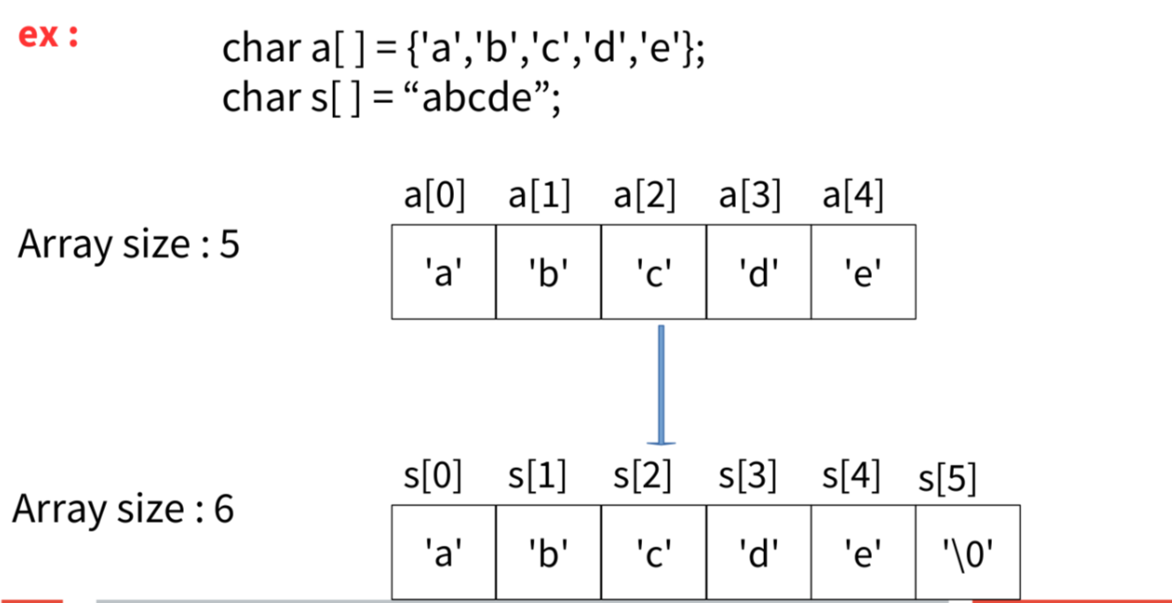
Character array size

Slide 76
Count of alphabets, digits & special char
#include<stdio.h>
int main()
{
char s[20];
int i,Upper=0,Lower=0,Digit=0,Spl=0;
printf("Enter the string\n");
scanf("%[^\n]",s);
printf("s = %s\n",s);
for(i=0;s[i];i++)
{

Slide 77
for(i=0;s[i];i++;
{
if((s[i]>=65)&&(s[i]<=90))
Upper++;
else if((s[i]>=97)&&(s[i]<=122))
Lower++;
else if((s[i]>=48)&&(s[i]<=57))
Digit++;
else
Spl++;
}

Slide 78
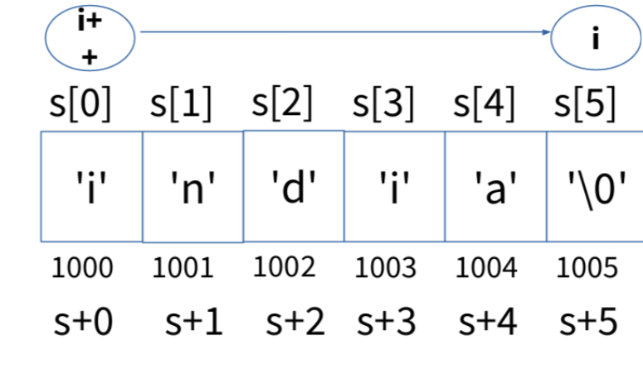
Program to find the string length
#include<stdio.h>
int main()
{
char s[20] = "india";
int i;
for(i=0;s[i]!='\0';i++);
printf("string length : %d\n",i);
printf("array size : %d\n",sizeof s);
}

Slide 79
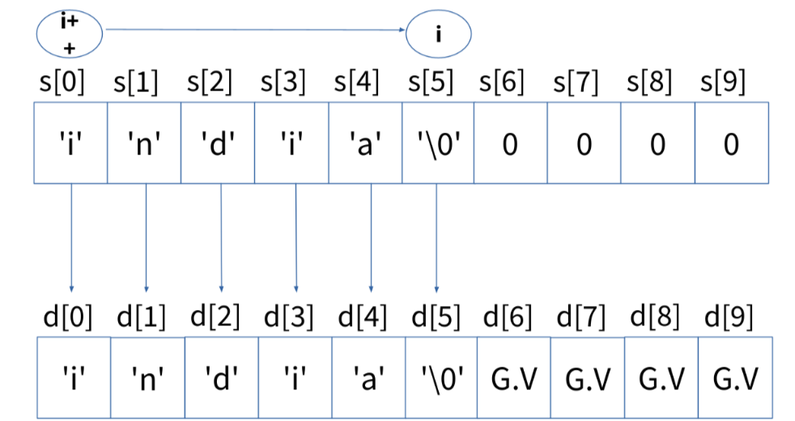
Program to copy a string from
source array to destination array

Slide 80
#include<stdio.h>
int main()
{
char s[50],d[20];
int i,j;
printf("Enter the sourse string\n");
scanf("%[^\n]",s);
printf("Enter the destination string\n");
scanf("%s",d);
for(i=0;d[i] = s[i];i++);
printf("source --> %s\n",s);
printf("destination --> %s\n",d);
}

Slide 81
Storage class
For a variable there is not only data type, there is one more attribute also available called storage class.
Syntax : Storage-class Data type variable.
Storage classes provides more information about variables and
functions. Storage class provides,
Default value.
Memory Allocation.
Scope ( Visibility )
Lifetime.

Slide 82
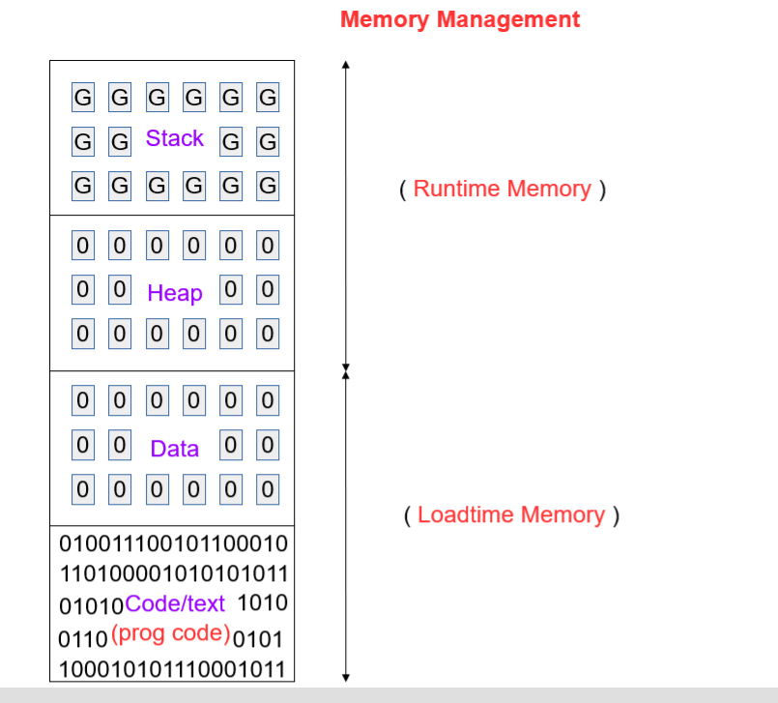

Slide 83
Types of Storage Class
There are four storage classes in C they are as follows:
1) Automatic (auto)
2)Register (register)
3)Static (static)
4)External (extern)

Slide 84
auto(automatic)
Default value : Garbage value
Memory : Stack
Scope : block/function
Lifetime : block/function
Advantage : As a local variable, provides data security.
Note :
1. The default storage class for local variable is auto
2. All auto variables are local variables, but all local variables are not auto variables.
3. Declaring auto storage class for global variable is not possible.

Slide 85
#include<stdio.h>
int main()
{
auto int x;
printf("x = %d\n",x); // prints Garbage value
}
Output : x = -1217232896
Example1 :

Slide 86
Example2:
#include<stdio.h>
auto int x; //compile time error.
int main()
{
printf("x = %d\n",x);
}
Note : auto variables must be local, should not be global.

Slide 87
register
Default value : Garbage value
Memory : Internal CPU registers
Scope : block/function
Lifetime : block/function
Advantage : faster in execution.
Note :
1. Declaring register storage class for global variable is not possible.
2. If there is no enough memory in internal CPU registers, then registers are
stored in stack memory.
3. register storage class variables addresses can't be accessed.

Slide 88
Example1 :
#include<stdio.h>
int main()
{
register int x;
printf("x = %d\n",x); // prints Garbage value
}
Output : x = -1217232896

Slide 89
Example2 ::
#include<stdio.h>
register int x; //compile time error.
int main()
{
printf("x = %d\n",x);
}
Note : register variables must be local, should not be global.

Slide 90
static
Default value : Zero
Memory : Data section
Scope : block/function for local variables Program for global variables
Lifetime : Program.
Advantage : static variables are used for counting purpose.
Note :
1. re-initialization is not possible, because the variable can't be re- created
2. static variables can be local or global.

Slide 91
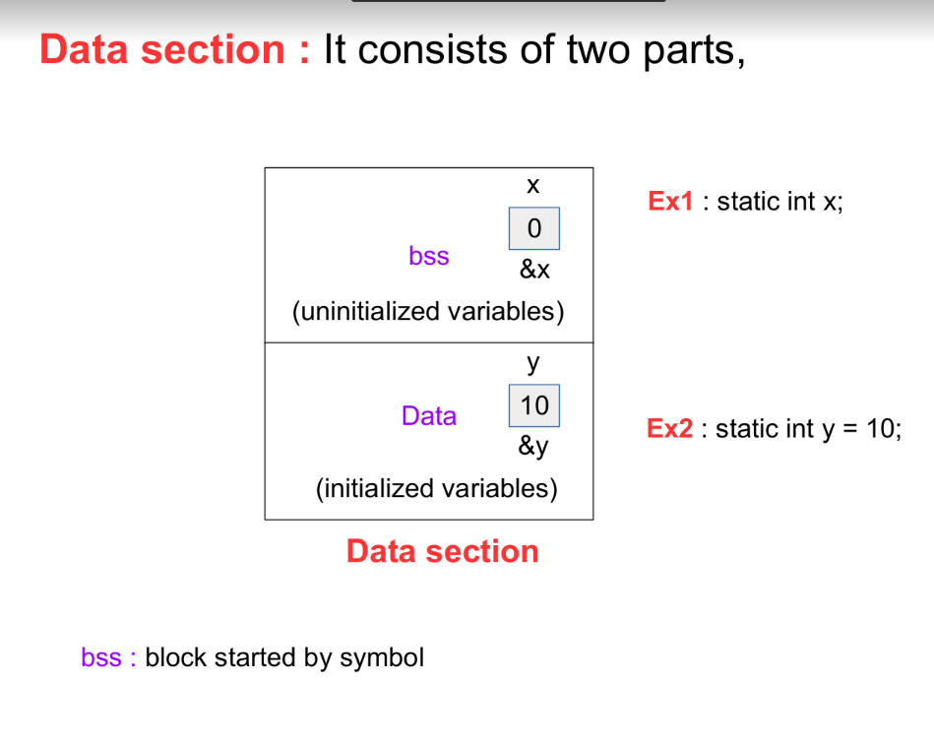

Slide 92
Example1 :
#include<stdio.h>
int main()
{
static int x; //'x' is stored in bss
printf("x = %d\n",x);
}
output : x = 0;

Slide 93
Example2 :
#include<stdio.h>
int main()
{
static int x = 10; //'x' stored in data section
printf("x = %d\n",x);
}
output : x = 10;

Slide 94
extern
Default value : Zero
Memory : Data section
Scope : function/program
Lifetime : Program
extern storage class consists of 2 types of statements.
1. extern declaration.
2. extern definition.
→ extern declaration is used to fetch the data from extern definition. extern definition may present in same file or other file
of the same program.
→ By default, all global variables are treated as extern storage
class variables.

Slide 95
Example1 :
#include<stdio.h>
int x = 10; //extern int x = 10; //extern definition
int main()
{
extern int x; //extern declaration.
printf("x = %d\n",x);
}
Output : x = 10

Slide 96
Example2 :
#include<stdio.h>
int main()
{
extern int x; //extern declaration.
printf("x = %d\n",x);
}
int x = 10; //extern definition.
Output : x = 10

Slide 97
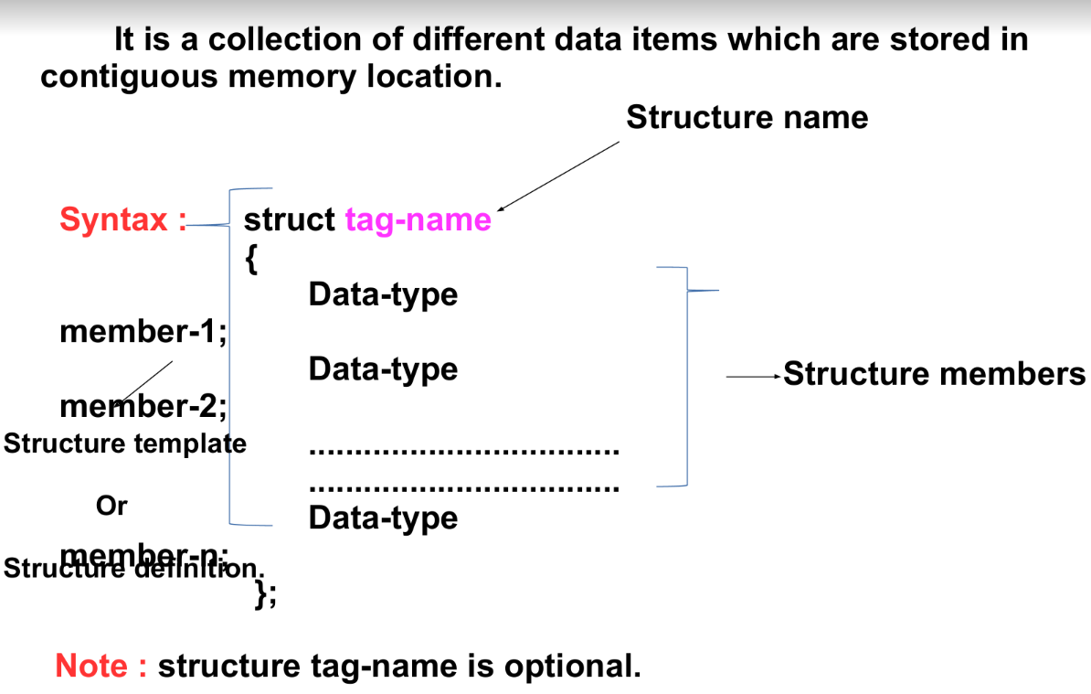
structure

Slide 98
--> for structure definitions there is no memory is allocated.
--> structure memory is basically allocated when a structure variable is declared.
Q) How to declare a structure variable?
A) in 2 ways it is possible to declare a structure variable.
1. along with structure definition.
2. using structure tag-name.

Slide 99
1. along with structure definition :
struct tag-name
{
......
......
}var1, var2,var3...;
2. using structure tag-name :
struct tag-name
{
......
......
};
struct tag-name var1,var2,var3...;

Slide 100
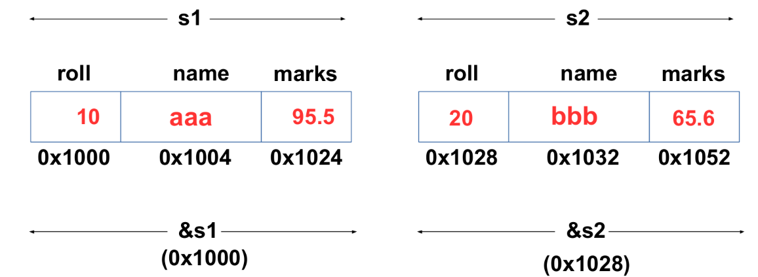
A student record ---> roll, name & marks
struct student
{
int roll;
char name[20];
float marks;
}s1 = {10,”aaa”,95.5} , s2 = {20,”bbb”,65.6};

Slide 101
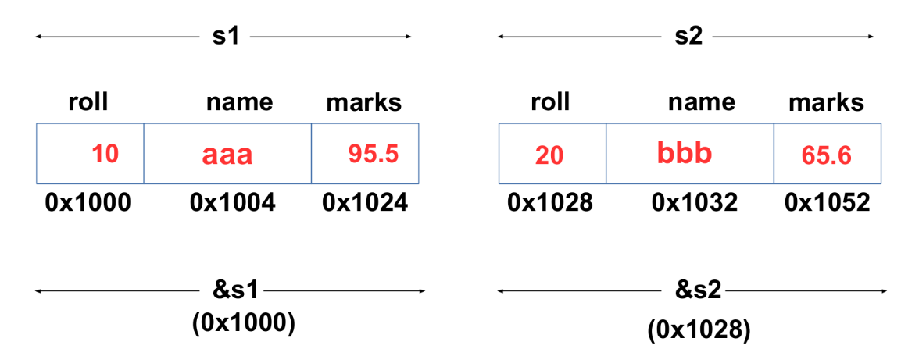
A student record ---> roll, name & marks
struct student
{
int roll;
char name[20];
float marks;
}s1 = {10,”aaa”,95.5} , s2 = {20,”bbb”,65.6};

Slide 102
Q) How to access the structure members?
A) using 2 operators.
1) using . (dot) operator
2) using -> (arrow) operator
Use .(dot) operator when you want to access the structure
Members from structure variable.
Use ->(arrow) operator when you want to access the structure members from structure variable address.
s1 variable members access.
s1.roll or (&s1)->roll
s1.name or (&s1)->name
s1.marks or (&s1)->marks
s2 variable members access.
s2.roll or (&s2)->roll
s2.name or (&s2)->name
s2.marks or (&s2)->marks

Slide 103
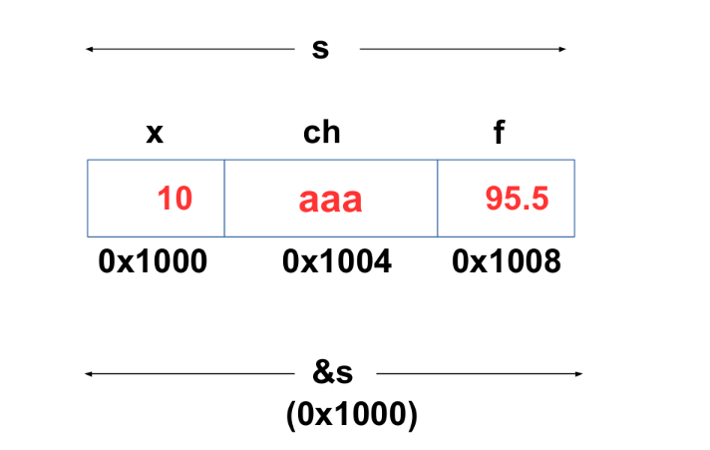
Note : 1.
structure tag-name is optional if structure variable is declared along with structure definition.
2. structure tag-name is must, if structure variable need to be declared after structure definition.
struct st
{
int x;
char ch;
float f;
};
struct st s;

Slide 104
Example 1:
#include<stdio.h>
struct student
{
int roll;
char name[20];
float marks;
}s1 = {10,"aaa",99.5},s2 = {20,"bbb",65.6};
int main()
{
printf("s1 data...\n");
printf("roll - %d %d\n",s1.roll,(&s1)->roll);
printf("name - %s %s\n",s1.name,(&s1)->name);
printf("marks - %f %f\n",s1.marks,(&s1)->marks);
printf("s2 data...\n");
printf("roll - %d %d\n",s2.roll,(&s2)->roll);
printf("name - %s %s\n",s2.name,(&s2)->name);
printf("marks - %f %f\n",s2.marks,(&s2)->marks);
}

Slide 105
Example 2:
#include<stdio.h>
int main()
{
struct
{
int x;
char ch;
float f;
}s = {10,'A',4.5};
printf("%d %c %f\n",s.x,s.ch,s.f); //data of members
printf("%d %c %f\n",(&s)->x,(&s)->ch,(&s)->f); //data of members
printf("%p %p %p\n",&s.x,&s.ch,&s.f); //addr of members
printf("%p %p %p\n",&(&s)->x,&(&s)->ch,&(&s)->f);//addr of members
}

Slide 106
Example 3:
//write a program to scan the data to a structure variable and display it.
#include<stdio.h>
int main()
{
struct st
{
int x;
char ch;
float f;
};
struct st s;
printf("Enter the structure data 1)int 2)char 3)float\n");
scanf("%d %c%f",&s.x,&s.ch,&s.f);
printf("x - %d ch - %c f - %f\n",s.x,s.ch,s.f);
}

Slide 107
Example 4:
#include<stdio.h>
struct st
{
int x;
struct st v; //invalid
char ch;
};
int main()
{
}
//Note : A structure should not contain same structure
variable as its member.
//A structure variable memory is unable to allocate, if the
structure definition is incomplete.

Slide 108


